Slide 1
Arduino: Eine kurze Einführung (Nov. 2015)
Wolfgang.Keller@wobilix.de

Slide 2
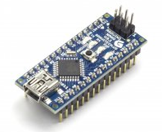
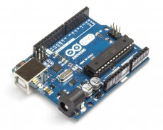
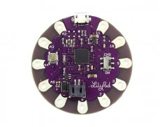
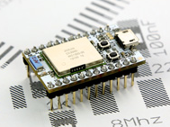
Was ist Arduino
http://www.arduino.cc
Familie programmierbarer Mikro-Controller
Vereinfachen des elektronischen Designs
Rapid Prototyping
Hacker, Maker Community
DIY

Slide 3
Warum!
„nur“ ein Mikro-Controller
Ein-/Ausschalten ohne booten
Billig und flexibel
Direktes interagieren mit Hardware
Viele Libraries verfügbar für verschiedene HW
Wirklich geringer Stromverbrauch (<mA im Winterschlaf)
Fun

Slide 4
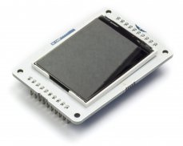
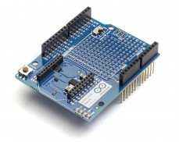
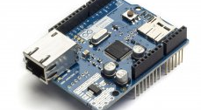
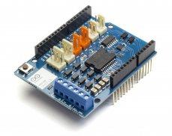
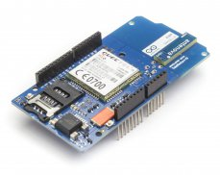
Shields
Erweiterungen
Auf das Arduino Board steckbar

Slide 5
Arduino Uno R3
Microcontroller | ATmega328
Operating Voltage | 5V
Input Voltage (recommended) | 7-12V
Input Voltage (limits) | 6-20V
Digital I/O Pins | 14 (of which 6 provide PWM output)
Analog Input Pins | 6
DC Current per I/O Pin | 40mA
DC Current for 3.3V Pin | 50mA
Flash Memory | 32 KB (ATmega328) of which 0.5 KB used by bootloader
SRAM | 2 KB (ATmega328)
EEPROM | 1 KB (ATmega328)
Clock Speed | 16MHz

Slide 6
Unterstützte Programmiersprachen
C/C++ (C++ 11)
Java
Processing – auf dem Host PC zur Darstellung von Daten
...

Slide 7
Developement Tools
Arduino IDE (1.0.6 oder 1.5.8 Beta)
Atmel Studio
Microsoft Visual Studio
Eclipse mit Plug-in
NetBeans mit und ohne Plug-in
Diverse webbasierende IDE
...

Slide 8
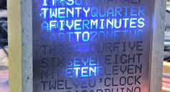
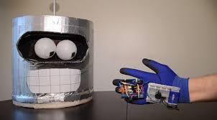
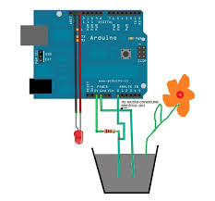
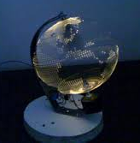
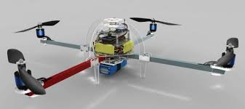
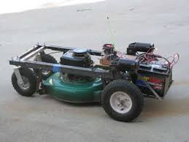
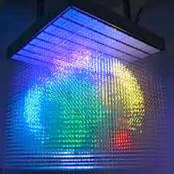
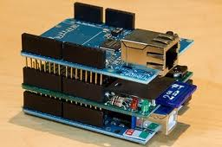
Projekte

Slide 9
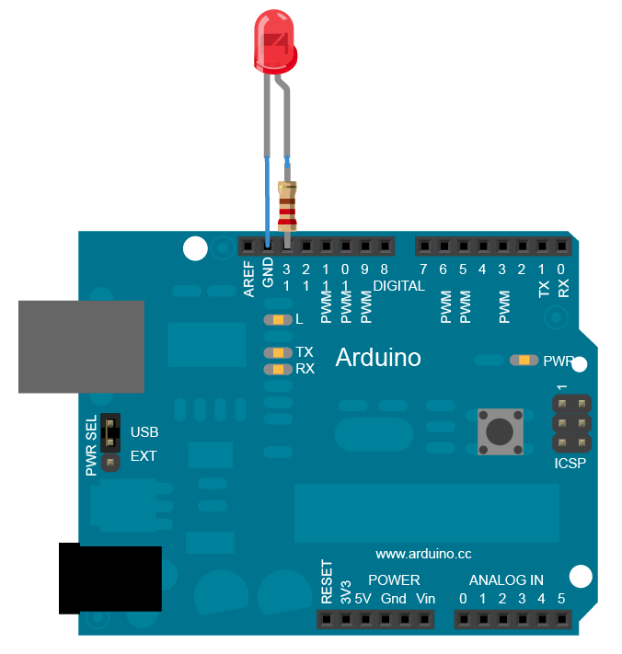
Beispiel: Blink
/*
Blink
Turns on an LED on for one second, then off for one second, repeatedly.
This example code is in the public domain.
*/
// Pin 13 has an LED connected on most Arduino boards.
// give it a name:
int led = 13;
// the setup routine runs once when you press reset:
void setup() {
// initialize the digital pin as an output.
pinMode(led, OUTPUT);
}
// the loop routine runs over and over again forever:
void loop() {
digitalWrite(led, HIGH); // turn the LED on (HIGH is the voltage level)
delay(1000); // wait for a second
digitalWrite(led, LOW); // turn the LED off by making the voltage LOW
delay(1000); // wait for a second
}

Slide 10
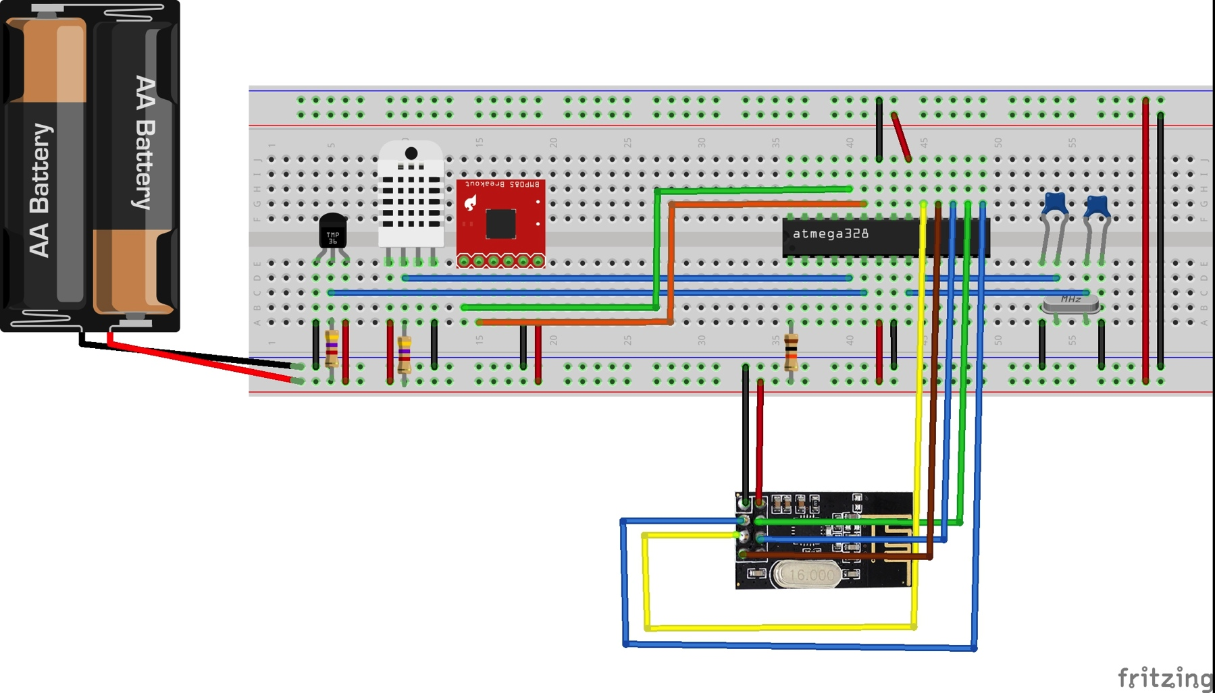
Beispiel: Wetterstation/Sender
Arduino mit Atmega328p ersetzt
Nächster Schritt des Prototyping
Microcontroller mit Temperatur-, Luftdruck- und Luftfeuchtigkeitssensor
Billigere Komponenten

Slide 11
Beispiel: Wetterstation/Sender
#include "WetterStationSender.h“
#define ONE_WIRE_BUS 4
#define DHT22_PIN 3
#define CE_PIN 9
#define CSN_PIN 10
#define PRINTF_BUF 20
OneWire oneWire(ONE_WIRE_BUS);
DallasTemperature sensors(&oneWire);
uint8_t getDeviceCount = 0;
dht DHT;
RF24 radio(CE_PIN, CSN_PIN);
const uint64_t pipe = 0xF0F0F0F0E1LL;
Adafruit_BMP085 bmp;
bool BMP085 = false;
char buf[PRINTF_BUF];
char str[8];
void setup() {
Serial.begin(115200);
setupRF24();
setupDS18x20();
setupBMP085();
}
void loop() {
getDS18x20();
getDHT22();
getBMP085();
sendData("eof");
sleep();
}
void sleep() {
radio.powerDown();
for (int i = 0; i < 10; i++) {
LowPower.powerDown(SLEEP_8S, ADC_OFF, BOD_OFF);
}
radio.powerUp();
}
void setupRF24() {
printf_begin();
radio.begin();
radio.setAutoAck(1);
radio.setRetries(15, 15);
radio.enableDynamicPayloads();
radio.openWritingPipe(pipe);
}
void setupDS18x20() {
sensors.begin();
getDeviceCount = sensors.getDeviceCount();
if (getDeviceCount != 0) {
sensors.setResolution(TEMP_12_BIT);
}
}
void getDS18x20() {
if (getDeviceCount > 0) {
sensors.requestTemperatures();
sprintf(buf, "%dx DS18x20", getDeviceCount);
sendData(buf);
for (int i = 0; i < getDeviceCount; i++) {
dtostrf(sensors.getTempCByIndex(i), 3, 2, str);
sprintf(buf, " t(%d)=%s", i, str);
sendData(buf);
}
}
}
void getDHT22() {
if (DHT.read22(DHT22_PIN) == DHTLIB_OK) {
sendData("DHT22");
dtostrf(DHT.temperature, 3, 2, str);
sprintf(buf, " t=%s", str);
sendData(buf);
dtostrf(DHT.humidity, 3, 2, str);
sprintf(buf, " f=%s", str);
sendData(buf);
}
}
void setupBMP085() {
if (bmp.begin()) {
BMP085 = true;
}
}
void getBMP085() {
if (BMP085) {
sendData("BMP085");
dtostrf(bmp.readTemperature(), 3, 2, str);
sprintf(buf, " t=%s", str);
sendData(buf);
dtostrf(bmp.readPressure() / 100, 3, 2, str);
sprintf(buf, " p=%s", str);
sendData(buf);
dtostrf(bmp.readAltitude(), 3, 2, str);
sprintf(buf, " h=%s", str);
sendData(buf);
dtostrf(bmp.readSealevelPressure() / 100, 3, 2, str);
sprintf(buf, " p0=%s", str);
sendData(buf);
dtostrf(bmp.readAltitude(101500), 3, 2, str);
sprintf(buf, " hr=%s", str);
sendData(buf);
}
}
void sendData(char *buf) {
Serial << buf << endl;
radio.write(buf, strlen(buf));
delay(100);
}

Slide 12
Beispiel: Wetterstation/Empfänger
#include "WetterStationEmpfaenger.h“
#define CE_PIN 9
#define CSN_PIN 10
#define PRINTF_BUF 20
RF24 radio(CE_PIN, CSN_PIN);
const uint64_t pipe = 0xF0F0F0F0E1LL;
char buf[PRINTF_BUF];
void setup() {
Serial.begin(115200);
setupRF24();
}
void loop() {
while (radio.available()) {
uint8_t len = radio.getDynamicPayloadSize();
radio.read(buf, len);
buf[len] = '\0';
Serial << buf << endl;
}
}
void setupRF24() {
printf_begin();
radio.begin();
radio.setAutoAck(1);
radio.setRetries(15, 15);
radio.enableDynamicPayloads();
radio.openReadingPipe(1, pipe);
radio.startListening();
}

Slide 13
Links
Arduino IDE http://arduino.cc/en/Main/Software
Eclipse plug-in/ suche nach Arduino im Marketplace http://www.baeyens.it/eclipse
Sprachen http://arduino.cc/en/Reference/HomePage
Libraries http://arduino.cc/de/Reference/Libraries
Processing https://www.processing.org
Boards und Shields http://arduino.cc/en/Main/Products
Fritzing http://fritzing.org/home
RWTH-Aachen http://hci.rwth-aachen.de/arduino http://hci.rwth-aachen.de/dorkbot

