Slide 1
Signals and Lambdas
Sven Johannsen
C++ User Group Aachen 01/08/15

Slide 2
Content
Qt 4
Signal and Slot Introduction
The connect() Problem
Qt5
New Syntax
C++ Lambdas as Qt Slots
Simple Webbrowser
New features - new problems

Slide 3
Qt Signal and Slot Introduction
Qt4
MyWidget Header:
class MyWidget : public QWidget
{
Q_OBJECT
public:
explicit MyWidget(QWidget *parent = 0);
private slots:
void helloW();
};

Slide 4
Qt Signal and Slot Introduction
Qt4
MyWidget constructor:
MyWidget::MyWidget(QWidget *parent): QMainWindow(parent)
{
auto* button = new QPushButton("Klick mich", this);
button->setGeometry(20,20,140,140);
connect(button, SIGNAL(clicked()), this, SLOT(helloW()));
}

Slide 5
Qt Signal and Slot Introduction
Qt4
helloW Slot:
void MyWidget::helloW()
{
QMessageBox::information(this, nullptr, "Hallo World");
}

Slide 6
The connect() Problem
Qt4
connect(button, SIGNAL(clicked()), this, SLOT(helloW()));
MACROs
Not compile time save!
Not a function call, but function call syntax
Slots has to be a widgets member functions
A lot of text for simple actions

Slide 7
New Syntax
Qt5
connect(button,&QPushButton::clicked,this,&MainWindow::hello);
No MACROs, pure C++
Type safe
Support for all(?) kinds of callable types
Member functions (no need for slots)
Non-member functions
Functors, std::function, lambda expressions
…

Slide 8
New Syntax
Qt5
goto source_code;

Slide 9
C++11 Lambda expressions
[ capture ] ( parameter) -> return_type { body; } ();
+ mutable, throw
mandatory:
[ ] => lambda-introducer
{ } => Body
Shortest Lambda: []{}
[]{}(); // Calls an empty lambda

Slide 10
C++11 Lambda expressions
Examples (new STL algorithms):
vector<int> v{ 13, 15, 19, 3 };
bool b1 = all_of(begin(v), end(v), [](int i){ return i % 2; }); // true bool b2 = any_of(begin(v), end(v), [](int i){ return i < 0; }); // false bool b3 = none_of(begin(v), end(v), [](int i){ return i < 0; }); // true

Slide 11
C++ Lambdas as Qt Slots
Qt5
connect(button, &QPushButton::clicked, [] {
QMessageBox::information(nullptr,
nullptr, "Hallo Lambda");
});

Slide 12
C++11 Lambda expressions Captures
[] Capture nothing – only lambda-introducer
[=],[&]Capture everything as copy or reference
[bar] Capture bar as copy and nothing else
[&foo] Capture foo as reference and nothing else
[this] Capture this pointer

Slide 13
C++ Lambdas as Qt Slots capture “this”
Qt5
connect(button, &QPushButton::clicked, [this]{
QMessageBox::information(this, nullptr,
"Hallo Lambda");
});

Slide 14
C++ Lambdas as Qt Slots parameters
Qt5
connect(webView, &QWebView::titleChanged,[this]
(const QString& title){
setWindowTitle(title);
});

Slide 15
C++ Lambdas as Qt Slots
Qt5
goto source_code;
// lambdas and simplebrowser

Slide 16
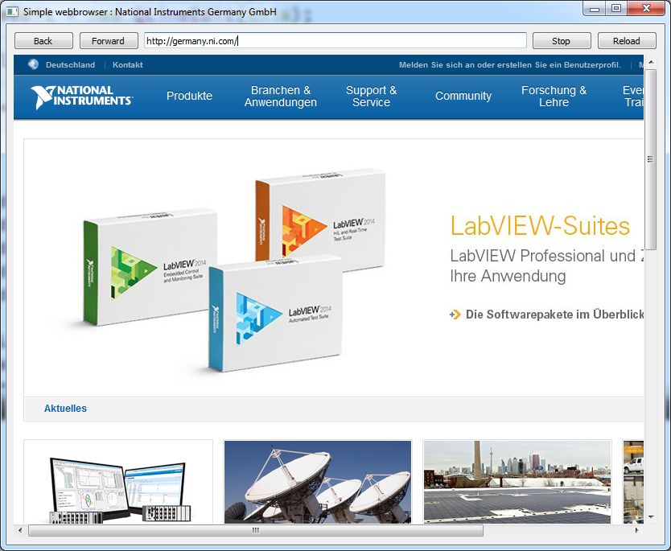
Simple Webbrowser

Slide 17
Connect: new features - new problems
Qt5
Disconnect
Overloads
(Default argument in slots are not supported)

Slide 18
Disconnect
Disconnect, if the life time is not synchronized
MainWindow::~MainWindow()
{
....
connect(button, &QPushButton::clicked, this, &MainWindow::world);
}
MainWindow::~MainWindow()
{
disconnect(button, &QPushButton::clicked, this, &MainWindow::world);
}

Slide 19
Disconnect
Disconnect, if the life time is not synchronized
QMetaObject::Connection world_connection_;
MainWindow::~MainWindow()
{ . . .
world_connection_ =
connect(button, &QPushButton::clicked, this, &MainWindow::world);
}
MainWindow::~MainWindow()
{
disconnect(world_connection_);
}

Slide 20
Overloads
Overloaded signals or slots
QSpinbox: 2 signals with the same name
void | valueChanged(int i)
void | valueChanged(const QString & text)

Slide 21
Overloads
connect(spin, SIGNAL(valueChanged(int)), label, SLOT(setNum(int)));
connect(spin, &QSpinBox::valueChanged, label, &QLabel::setNum);
connect(spin,
static_cast<void(QSpinBox::*)(int)>(&QSpinBox::valueChanged),
label, static_cast<void(QLabel::*)(int)>(&QLabel::setNum));

Slide 22
Disconnect & Overloads
goto source_code;

Slide 23
Questions?

Slide 24
simplebrowser.pro
QT += core gui webkitwidgets webkit widgets win32-g++: QMAKE_CXXFLAGS += -std=c++11 TARGET = simplebrowser TEMPLATE = app SOURCES += main.cpp HEADERS += simplebrowser.h

Slide 25
main.cpp
#include <QApplication> #include "simplebrowser.h"
int main(int argc, char *argv[])
{
QApplication a(argc, argv); MainWindow w; w.show(); return a.exec();
}

Slide 26
simplebrowser.h
#pragma once #include <QMainWindow>
#include <QLayout>
#include <QLineEdit>
#include <QPushButton>
#include <QtWebKitWidgets/QWebView>
struct MainWindow : QMainWindow
{
MainWindow()
{
auto central = new QWidget();
auto webView = new QWebView(this);
auto urlLineEdit = new QLineEdit(this);
auto layout = new QVBoxLayout(central);
auto controls = new QHBoxLayout();
auto back = new QPushButton("Back", this);
auto forward = new QPushButton("Forward", this);
auto stop = new QPushButton("Stop", this);
auto reload = new QPushButton("Reload", this);
controls->addWidget(back);
controls->addWidget(forward);
controls->addWidget(urlLineEdit);
controls->addWidget(stop);
controls->addWidget(reload); layout->addLayout(controls);
layout->addWidget(webView);
central->setLayout(layout);
setCentralWidget(central);
connect(back, &QPushButton::clicked, [webView] { webView->back(); });
connect(forward, &QPushButton::clicked, [webView] { webView->forward(); });
connect(stop, &QPushButton::clicked, [webView] { webView->stop(); });
connect(reload, &QPushButton::clicked, [webView] { webView->reload(); }); connect(urlLineEdit, &QLineEdit::returnPressed, [urlLineEdit, webView] { webView->load(QUrl(urlLineEdit->text())); }); connect(webView, &QWebView::urlChanged, [urlLineEdit](const QUrl& url) { urlLineEdit->setText(url.toString()); }); connect(webView, &QWebView::titleChanged, [this](const QString& title) { setWindowTitle("Simple webbrowser : " + title); });
emit webView->titleChanged("");
//webView->load(QUrl("http://sven-johannsen.de"));
webView->load(QUrl("http://127.0.0.1:8080"));
webView->show();
}
};

